Slide 1


ACT® Aspire®
Creating Reporting Groups in PearsonAccess^{next}
Notes:
Welcome to the ACT® Aspire® Creating Reporting Groups in PearsonAccess^{next} training.

Slide 2




Agenda
Purpose of Reporting Groups
Process for Creating Reporting Groups
ACT® Aspire® PearsonAccess^{next} Resources
Notes:
During the training, we’ll review the purpose of Reporting Groups, the process for creating Reporting Groups, and ACT Aspire PearsonAccess^{next} resources.

Slide 3
purpose of reporting groups
Notes:
First, we will discuss the purpose of Reporting Groups in PearsonAccess^{next} .

Slide 4

Purpose of reporting groups
Pearsonaccess Next
Reporting Groups are optional.
Students may belong to multiple reporting groups.
Multiple users may be granted permission to view a reporting group.
Reporting Groups are available to view in:
OnDemand Reports
Current Progress Report
Proficiency Reports
Historical Student Data
Reporting Groups can be created manually through the user interface or via the Reporting Groups Import.
Notes:
Creating Reporting Groups is optional for ACT Aspire. This option is available for those wanting to group students by classroom, teacher, or testing days for reporting purposes.
Students may belong to more than one Reporting Group.
Multiple users may be assigned to a single Reporting Group.
Reporting Groups are available to view in:
OnDemand Reports
Current Progress Report
Proficiency Reports
Historical Student Data
Reporting Groups can be created manually through the user interface or via the Reporting Groups Import.

Slide 5
Process for Creating reporting Groups
Notes:
Creating Reporting Groups in PearsonAccess^{next} may be completed by the Administration Test Coordinator and Test Coordinator roles.

Slide 6
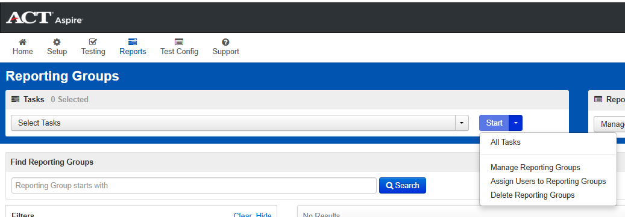
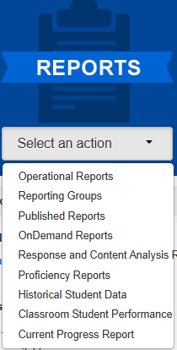
Create reporting groups
Reports > Reporting groups
Notes:
Start by going to “Reports > Reporting Groups”.
On the “Reporting Groups” page, click the dropdown to the right of the “Start” button. Then click “All Tasks”.

Slide 7
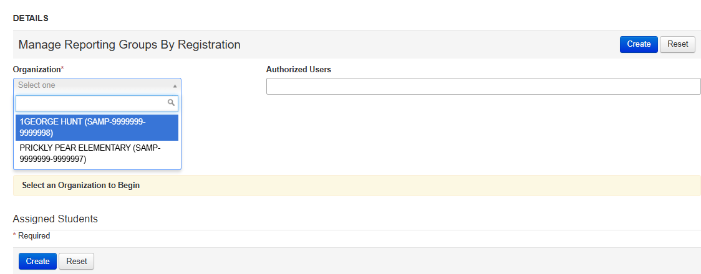
Create reporting groups
Manage Reporting Groups
Notes:
On the “Manage Reporting Groups” tab, select the desired school from the “Organization” dropdown menu.

Slide 8
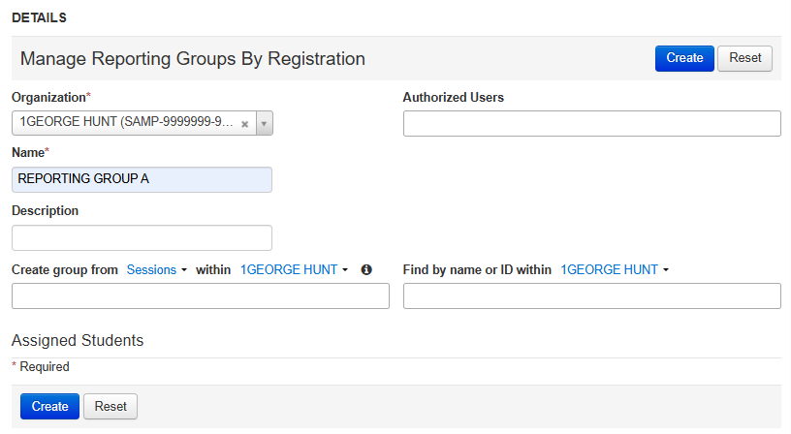
Create reporting groups
Manage Reporting Groups
Notes:
Next, fill in the Reporting Group “Name”. This is a required field.

Slide 9
Create reporting groups
Manage Reporting Groups
Notes:
To assign students to the Reporting Group, you can either search for students by group from “Sessions” or from “Groups/Classes”, or you can search for students individually. A Reporting Group may be created using Sessions, Groups or Classes, and students that are selected individually.

Slide 10
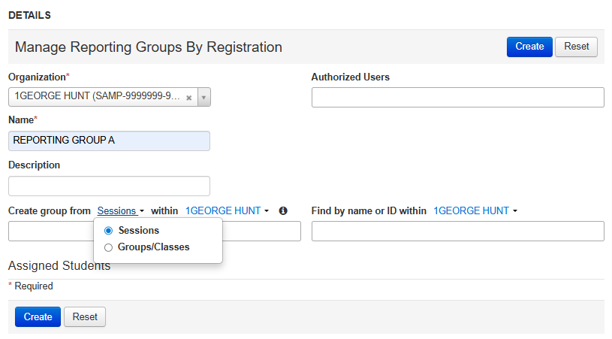
Create reporting groups
Manage Reporting Groups
Notes:
To assign students to the Reporting Group using “Sessions” or “Groups/Classes”, use the blue hyperlinked dropdown menu to select the “Sessions” or “Groups/Classes” option.

Slide 11
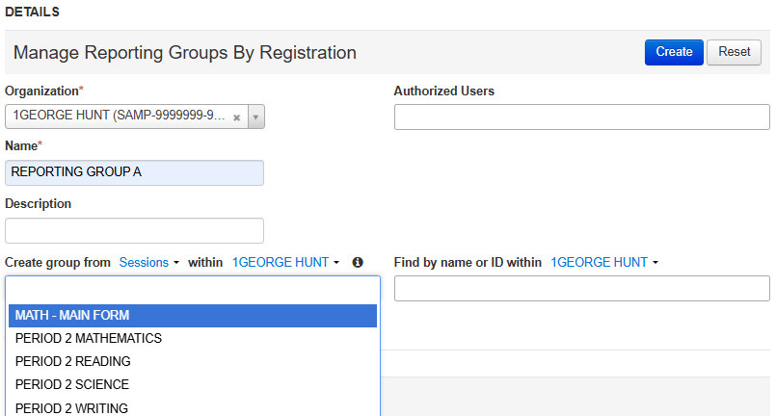
Create reporting groups
Manage Reporting Groups
Notes:
Once the selection is made, click in the field to activate the dropdown menu to select the Session, Class, or Group. This is a multiple-select field. To select more than one Session, Class, or Group, just click in the field again to reactivate the dropdown menu.

Slide 12
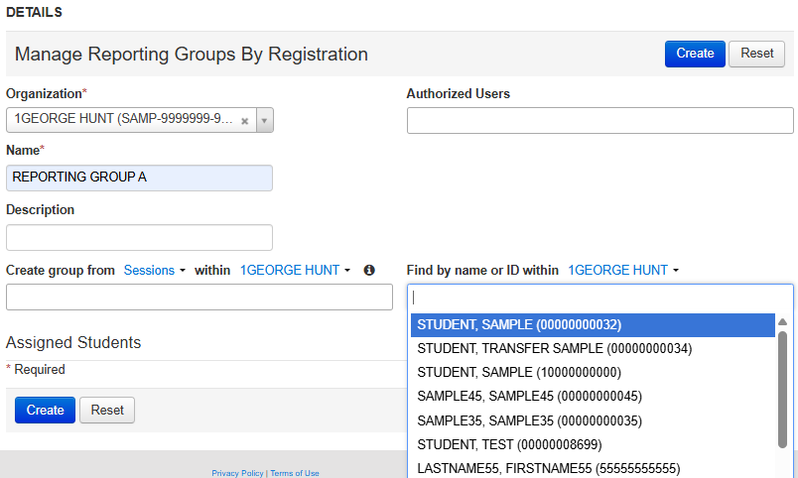
Create reporting groups
Manage Reporting Groups
Notes:
To assign students to the Reporting Group individually, use the “Find by name or ID” field. Click in the field to activate the student selection dropdown menu. You can type a student’s first or last name or SSID to filter the list down. This is a multiple-select field. To select more than one student, click in the field again to reactivate the student selection dropdown menu.

Slide 13
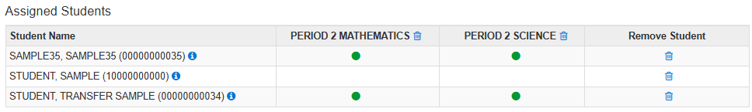
Create reporting groups
Manage Reporting Groups
Notes:
As Sessions, Groups, Classes, or individual students are selected, a roster list of assigned students will populate at the bottom of the screen. You may remove an entire group of students or an individual student from the Reporting Group. To remove a Session, Group, or Class, click the trashcan icon on the column header for the Session, Group, or Class. To remove an individual student from the Reporting Group, click the trashcan icon in the Remove Student column on the row for the desired student.

Slide 14
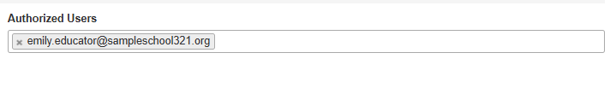
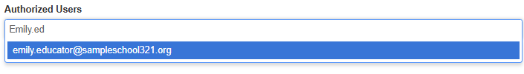
Create reporting groups
Assign authorized users
Notes:
Next, assign Authorized Users to the Reporting Group. These will be the users that can view Reports in PearsonAccess^{next} for these students, including OnDemand Reports, Current Progress Report, Proficiency Reports, and Historical Student Data. Authorized Users may be added by typing an email address or username for the desired user. This is a multiple-select field. To add additional Authorized Users, click in the field again to type the email address of the additional Authorized User.

Slide 15
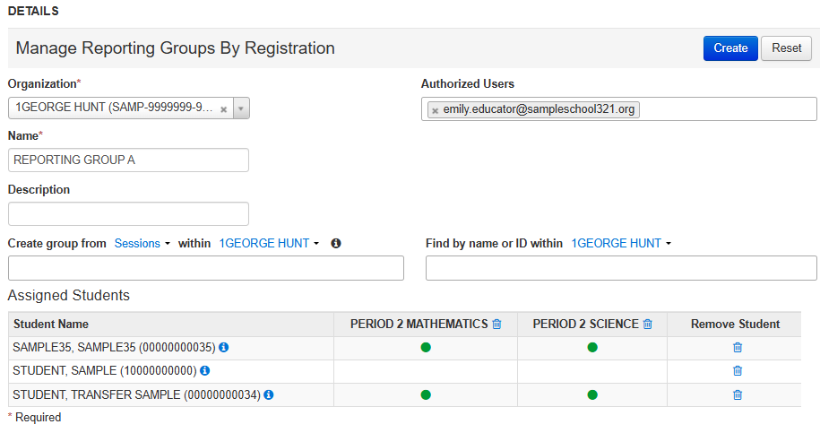
Create reporting groups
Assign authorized users
Notes:
Once the Reporting Group has a name, all students are selected, and an Authorized User has been assigned, click the “Create” button.

Slide 16
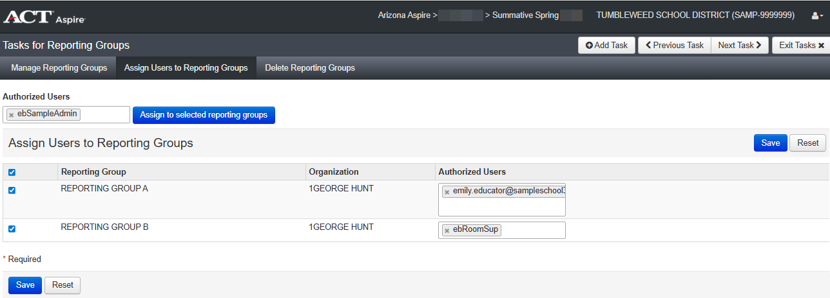
Create reporting groups
Assign users to Multiple Reporting Groups
Notes:
Once Reporting Groups are created, they will be populated on the “Assign Users to Reporting Groups” tab. You can assign additional Authorized Users to multiple Reporting Groups using the “Authorized Users” field. Add the desired user email address or username in the “Authorized Users” field.

Slide 17
Create reporting groups
Assign users to Multiple Reporting Groups
Notes:
Check the check boxes for each of the desired Reporting Groups.

Slide 18
Create reporting groups
Assign users to Multiple Reporting Groups
Notes:
Click the “Assign to selected reporting groups” button. Then click the “Save” button.

Slide 19
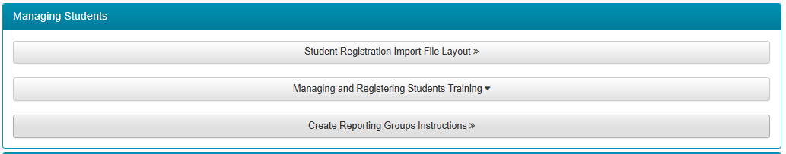
Resources
Web pages and Resources
Arizona ACT Aspire Support Page
https://az-support.mypearsonsupport.com/aspire/
Notes:
The Arizona ACT Aspire Support Page contains useful resources including the step-by-step document, Create Reporting Group Instructions.
We suggest bookmarking the Arizona ACT Aspire Support Page for future reference.

Slide 20

Questions? We’re here to help!
Pearson Customer Support
Phone: 1.888.705.9421 Option 4 (ACT Aspire), 7:00 a.m. – 7:00 p.m., central time, Monday through Friday
Notes:
This concludes the ACT Aspire Creating Reporting Groups in PearsonAccess^{next} training. If you have any questions, please contact us at the number provided on this slide.

